Slide 1
DIT341 - Lecture 9:
Mobile Development with Android
Gregory Gay
(Some slides by Grischa Liebel)

Slide 2
This Lecture
Android OS, SDK, and Runtime
Basics of native Android programming
Basic App Components
Activities and Intents
Manifest and Resources
Permissions
Layouts and Responsive UI Design
Making REST requests

Slide 3
Related Activities
Activity 20: Recommended
Practice Android with Codelabs for Android Developer Fundamentals (V2):
https://developer.android.com/courses/fundamentals-training/toc-v2
1.2 Part A: Your first interactive UI
1.3: Text and scrolling views
2.1: Activities and intents

Slide 4
What is a Mobile Application?
"A mobile app or mobile application is a computer program designed to run on a mobile device such as a phone/tablet or watch." - Wikipedia
Isn’t a mobile device just a smaller computer?
Mobility imposes restrictions on program design.
Computational Power (small devices, limited power)
Battery (must last for as long as possible)
Input Methods (may be touch only)
Screen Size (watch, small screen)
Unreliable Network Connection (can’t assume constant connection)
Notes:
So, you’ve developed all sorts of applications in this and other courses. Desktop applications, web applications, now mobile applications. What’s so special about mobile? LEt’s stat with a definition. Wikipedia - source of all knowledge - says (1). Well, (2). What makes it different? Well, the need to operate on the go. Laptops are technically portable, but mobile devices take this even further. (3 -4) Though, these days, there isn’t even that big of a difference. More importantly, (5) - optimization becomes important not because the hardware is weak, but because a mobile device must operate for a long period of time on a relatively small battery. Program design must consider the drain on power, and work to conserve battery life. (6) - you do not have a mouse, a full keyboard, maybe no buttons at all. You must use a touchscreen as your primary source of input. (7), which can vary from a watch to a tablet, but will always be on the small side - even if the screen is high resolution, apps must be readable and make use of the limited screen space. And, (8) - you can’t assume a constant network connection. Your cellular connection may weaken or drop, and you may switch from cellular to wifi at any time.

Slide 5
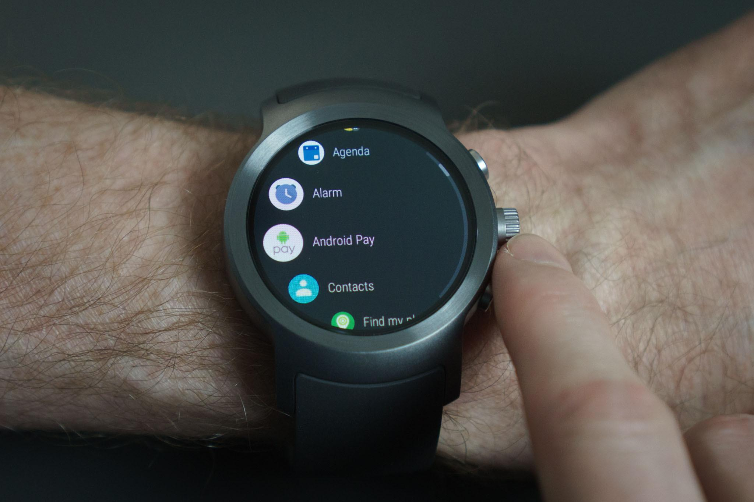
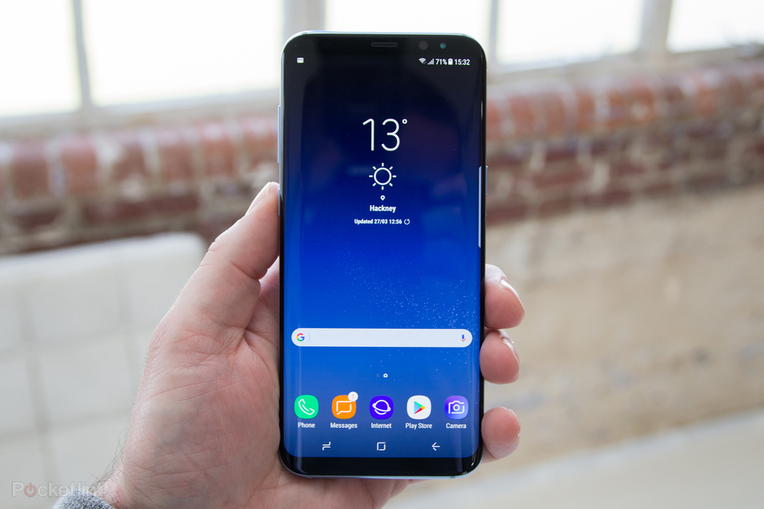
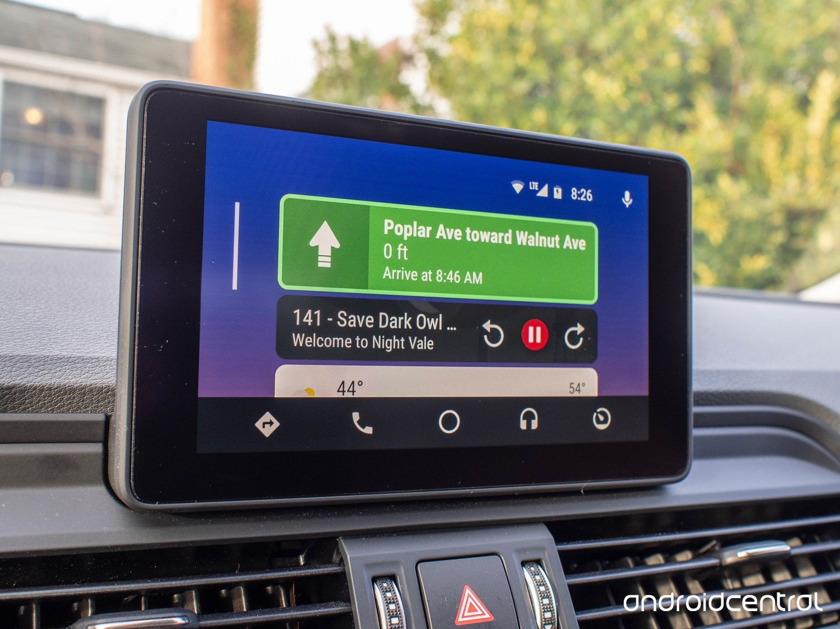
Differences from “Regular” Apps
Not strictly defined, but…
Mobile apps must adapt to multiple devices.
Different layouts for different screen sizes.
Can enable/disable features based on hardware.
Requires more thought about design and UX.
Notes:
What does this mean in terms of how we approach development? The difference from regular apps is (1) one key difference is adaptability. (2) - you can deploy the same app to anything from a watch, to a phone, to a tablet, to an in-car display or a VR headset.
Android allows you to provide different resources for different devices. For example, you can create different layouts for different screen sizes. Then the system determines which layout to use based on the current device's screen size.If any of your app's features need specific hardware, such as a camera or particular sensors, you can query whether the device has that hardware at runtime and then disable the corresponding features if not. You can also set some features as required so Google Play won't allow installation on devices without them. (last point), as the app needs to function, be responsive, and provide a pleasant user experience on a huge range of device types, power levels, and feature sets.

Slide 6
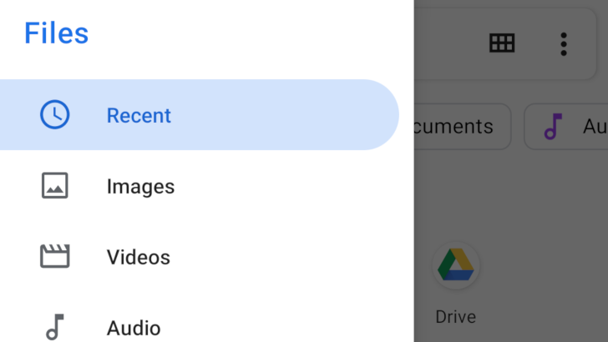
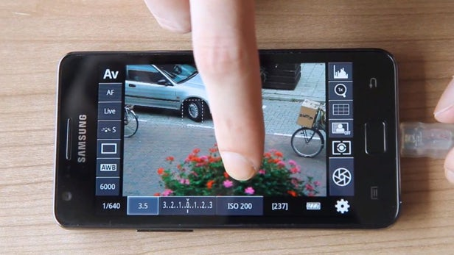

Differences from “Regular” Apps
Apps are designed to form an ecosystem.
Each app is a collection of components:
Activities provide a user interface.
The main activity starts when you tap the icon, but other apps can directly link to other “activities”.
Broadcast receivers and Services perform background tasks.
Apps often specialized for smaller tasks.
Purpose-built apps link to other apps for common features.
Notes:
(1), to work together. Android apps are built as a combination of components that can be invoked individually. For example, an activity is a type of app component that provides a user interface.
The "main" activity is what starts when the user taps your app icon, but you can take the user straight into a different activity from other places, such as from a notification or even from a different app. For instance, from the Twitter app, you can directly launch the camera, take a picture, and return to Twitter where you left off. Other components such as broadcast receivers and services also allow your app to perform background tasks without a user interface.
This means that (6) You wouldn’t build a full-blown office suite, but would have apps that each capture a portion of that functionality, which are free to link to each other. (last point). If you’re developing a social networking app, you wouldn’t build in camera functionality. YOu’d call the existing functionality. To upload a picture, you won’t build a viewer for the photos on the device, you just open the existing photo viewer.

Slide 7
Android
Most popular mobile operating system
2.5 billion active devices
Phones, tablets, watches, car displays, TVs, IoT devices, speakers, home automation, ...
Apps written in Android SDK.
Supports Java (this course), Kotlin, C++.
Code, data, resources compiled into APK.
Android Package
Compiled into device-specific code and run in Android OS (Linux-based).
Notes:
Android is (1). As of May 2019, there were (2), ranging from (3).
Android apps can be written using Kotlin, Java, and C++ languages. The Android SDK tools compile your code along with any data and resource files into an APK, an Android package, which is an archive file with an .apk suffix. One APK file contains all the contents of an Android app and is the file that Android-powered devices use to install the app. (last point)

Slide 8
Android Fundamentals
Each app operates in a sandbox.
Each app is a “user”.
Only that app can access its files.
Each app runs in its own virtual machine and process.
Android implements “principle of least privilege”.
Each app can access only components it requires.
Users must grant access to location, camera, bluetooth, files, etc.
Notes:
Each Android app lives in its own security sandbox
The Android operating system is a multi-user Linux system in which each app is a different user. By default, the system assigns each app a unique Linux user ID (the ID is used only by the system and is unknown to the app). The system sets permissions for all the files in an app so that only the user ID assigned to that app can access them. Each process has its own virtual machine (VM), so an app's code runs in isolation from other apps. By default, every app runs in its own Linux process. The Android system starts the process when any of the app's components need to be executed, and then shuts down the process when it's no longer needed or when the system must recover memory for other apps.
The Android system implements the principle of least privilege. That is, each app, by default, has access only to the components that it requires to do its work and no more. This creates a very secure environment in which an app cannot access parts of the system for which it is not given permission. Apps can share a user ID and access each other’s files, but this is not the default case. An app can request permission to access device data such as the device's location, camera, and Bluetooth connection. The user has to explicitly grant these permissions.

Slide 9
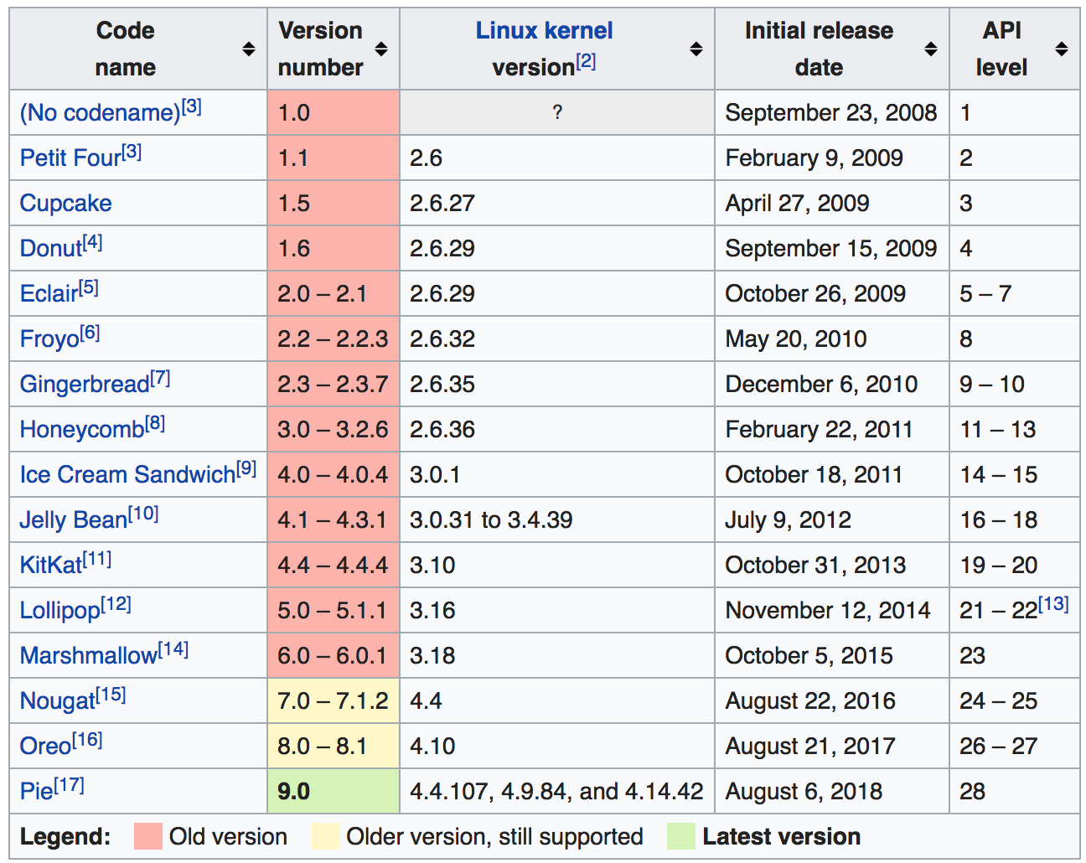
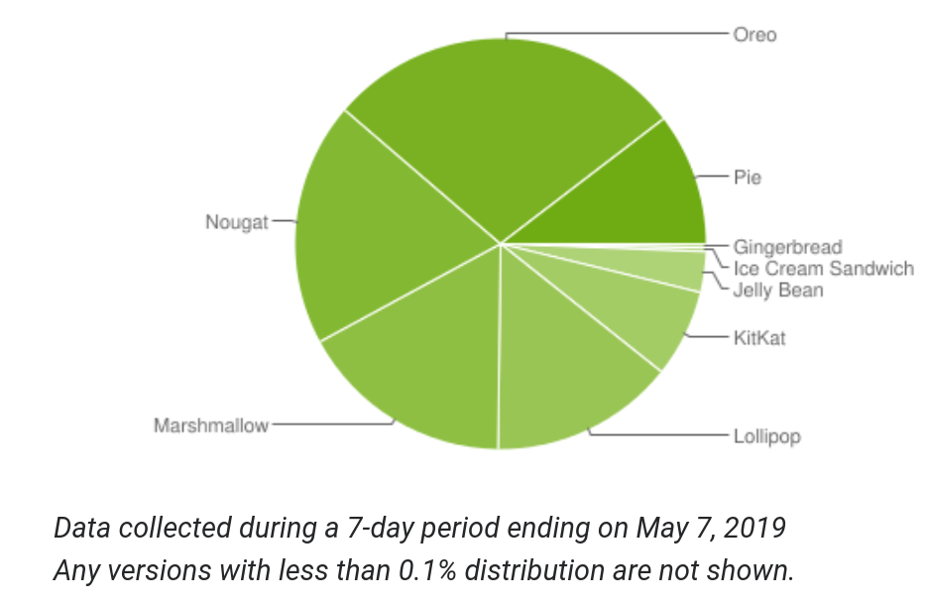
Versioning
Apps target a minimal “API level”.
Defines available features.
Apps must update compatibility or be disabled.
Notes:
(go over). This leads into one of the biggest challenges in devleopment - fragmentation. You can’t assume all users are on the same OS, and you must decide explicitly what versions of the OS you will support.
(bring in, go over)

Slide 10
Android Fundamentals

Slide 11
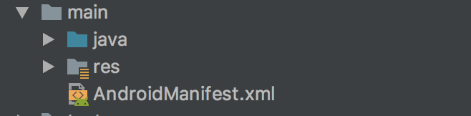
Android Apps - Structure
Android Code
All the logic
Resources
Manifest

Slide 12
App Components
Core building blocks of an app.
Entry points for an app.
Activities are “screens” with a UI.
Services run a task in the background.
Broadcast receivers deliver events to apps outside of regular user flow.
Content providers manage a pool of information.
Notes:
App components are the essential building blocks of an Android app. Each component is an entry point through which the system or a user can enter your app. There are four different types of app components:
(go over each)

Slide 13
Activities
A single screen with a user interface.
Most apps have multiple independent activities.
E-mail: Show messages, compose, read.
If allowed, other apps can start any activity.
Camera app opens “Compose” activity to share photo.
Activities control and link processes.
Ensure the current process is not killed.
Link to calling activities and maintain their process.
Model state in case process is killed.
Model flow between apps.
Notes:
An activity is the entry point for interacting with the user. It represents a single screen with a user interface.(2) For example, an email app might have one activity that shows a list of new emails, another activity to compose an email, and another activity for reading emails. Although the activities work together to form a cohesive user experience, each one is independent. As such, a different app can start any one of these activities if the app allows it. For example, a camera app can start the activity in the email app that composes new mail to allow the user to share a picture.
Activities keep track of what is currently on screen to ensure that the system keeps running the process that is hosting the activity. They know that previously used processes contain things the user may return to (stopped activities), and thus more highly prioritize keeping those processes around.
They helo the app handle having its process killed so the user can return to activities with their previous state restored.
They provide a way for apps to implement user flows between each other, and for the system to coordinate these flows.

Slide 14
Services
Entry point for running a background process.
Playing music, sending files.
Does not provide a direct UI.
Can be started by an activity.
Can maintain a notification to allow user interaction.
Services without notifications can be killed if resources are needed by OS.
Bound services offer an API to the calling app.
Maintained as long as needed, then killed.
Notes:
A service is a general-purpose entry point for keeping an app running in the background. It is a component that runs in the background to perform long-running operations or to perform work for remote processes. A service does not provide a user interface. For example, a service might play music in the background while the user is in a different app, or it might fetch data over the network without blocking user interaction with an activity. Another component, such as an activity, can start the service and let it run or bind to it in order to interact with it.
Started services tell the system to keep them running until their work is completed. Some services, like, Music playback aee something the user is directly aware of, so the app maintains a constant notification to tell the user about it; in this case the system knows that it should try really hard to keep that service's process running, because the user will be unhappy if it goes away. A regular background service is not something the user is directly aware as running, so the system has more freedom in managing its process - killing it if resources are needed.
Bound services run because some other app has said that it wants to make use of the service. This is basically the service providing an API to another process. The system thus knows there is a dependency between these processes, so if process A is bound to a service in process B, it knows that it needs to keep process B (and its service) running for A.Many other core system features are all built as services that applications implement and the system binds to when they should be running.

Slide 15
Broadcast Receivers
Allows OS to deliver events when the app is not running.
Listen to system-wide broadcast announcements.
Respond to events like a photo being taken.
Often notify users that an event has occurred.
Often minimal, used as a gateway to launch activities or services.
Notes:
A broadcast receiver is a component that enables the system to deliver events to the app outside of a regular user flow, allowing the app to respond to system-wide broadcast announcements. Because broadcast receivers are another well-defined entry into the app, the system can deliver broadcasts even to apps that aren't currently running. Many broadcasts originate from the system—for example, a broadcast announcing that the screen has turned off, the battery is low, or a picture was captured. Apps can also initiate broadcasts—for example, to let other apps know that some data has been downloaded to the device and is available for them to use.
Although broadcast receivers don't display a user interface, they may create a status bar notification to alert the user when a broadcast event occurs. More commonly, a broadcast receiver is just a gateway to other components and is intended to do a very minimal amount of work. For instance, it might launch a service to perform background processing.

Slide 16
Content Providers
Manages a shared set of app data.
Other, allowed, apps can query or modify the data.
Android has a Content Provider for contact data.
An entry point into an app for publishing data items.
Identified by a URI.
Owning app wakes up when a URI is accessed.
URIs provide a secure way to pass content.
Content is locked and accessed through temporary permission.
Notes:
A content provider manages a shared set of app data that you can store in any persistent storage location that your app can access - files, database, web resources. Through the content provider, other apps can query or modify the data if the content provider allows it. For example, the Android system provides a content provider that manages the user's contact information.
To the system, a content provider is an entry point into an app for publishing named data items, identified by a URI scheme. Thus an app can decide how it wants to map the data it contains to a URI namespace, handing out those URIs to other entities which can in turn use them to access the data. URIs can persist after their apps have exited. The system only needs to make sure that an owning app is still running when it has to retrieve the app's data from the corresponding URI.
These URIs also provide an important fine-grained security model. For example, an app can place the URI for an image it has on the clipboard, but leave its content provider locked up so that other apps cannot freely access it. When a second app attempts to access that URI on the clipboard, the system can allow that app to access the data via a temporary URI permission grant so that it is allowed to access the data only behind that URI, but nothing else in the second app.

Slide 17
Intents
Asynchronous messages that bind components at runtime.
Messengers that request actions from other components.
Start an activity, start a service, deliver a broadcast.
Can convey a result back to the caller.
Explicit intents activate a specific component.
Implicit intents activate types of components.
Notes:
A unique aspect of the Android system design is that any app can start another app’s component. Because the system runs each app in a separate process with file permissions that restrict access to other apps, your app cannot directly activate a component from another app. However, the Android system can. To activate a component in another app, deliver a message to the system that specifies your intent to start a particular component.
activities, services, and broadcast receivers—are activated by an asynchronous message called an intent. Intents bind individual components to each other at runtime. You can think of them as the messengers that request an action from other components, whether the component belongs to your app or another.
For activities and services, an intent defines the action to perform (for example, to view or send something) and the URI of the data to act on. For example, an intent might define a request for an activity to show an image or to open a web page. In some cases, you can start an activity to receive a result,. For example, you can issue an intent to let the user pick a personal contact and have it returned to you. For broadcast receivers, the intent simply defines the announcement being broadcast. For example, a broadcast to indicate the device battery is low
An intent defines a message to activate either a specific component (explicit intent) or a specific type of component (implicit intent).

Slide 18
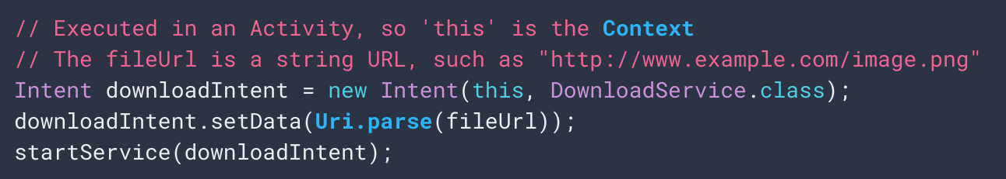
Explicit Intents
Name a specific app (by package or component).
Often used by one component to start another within the same app.
Notes:
Explicit intents specify which application will satisfy the intent, by supplying either the target app's package name or a fully-qualified component class name. You'll typically use an explicit intent to start a component in your own app, because you know the class name of the activity or service you want to start. For example, you might start a new activity within your app in response to a user action, or start a service to download a file in the background.
To create an explicit intent, define the component name for the Intent object—all other intent properties are optional.
For example, if you built a service in your app, named DownloadService, designed to download a file from the web, you can start it with the following code. The Intent(Context, Class) constructor supplies the app Context and the component a Class object. As such, this intent explicitly starts the DownloadService class in the app.

Slide 19
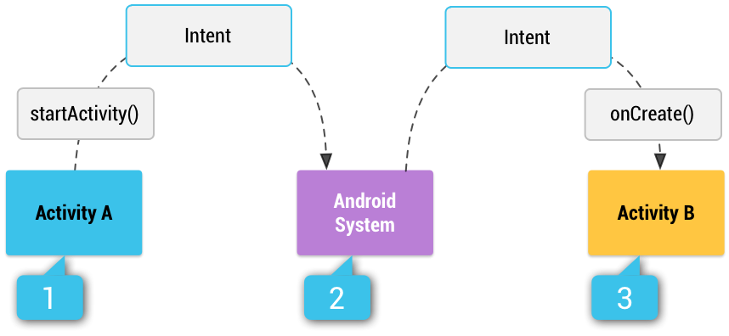
Implicit Intents
Describe a type of action you want to perform.
Allow the system to find components that can perform that action (selected by the user).
Done using IntentFilters
Notes:
You can also use an implicit intent, which describes the type of action to perform and, optionally, the data upon which you’d like to perform the action. The implicit intent allows the system to find a component on the device that can perform the action and start it. If there are multiple components that can perform the action described by the intent, the user selects which one to use.For example, if you want to show the user a location on a map, you can use an implicit intent to request that another capable app show a specified location on a map. When you use an implicit intent, the Android system finds the appropriate component to start by comparing the contents of the intent to the intent filters declared in the manifest file of other apps on the device. If the intent matches an intent filter, the system starts that component and delivers it the Intent object.
Activity A creates an Intent with an action description and passes it to startActivity(). [2] The Android System searches all apps for an intent filter that matches the intent. When a match is found, [3] the system starts the matching activity (Activity B) by invoking its onCreate() method and passing it the Intent.

Slide 20
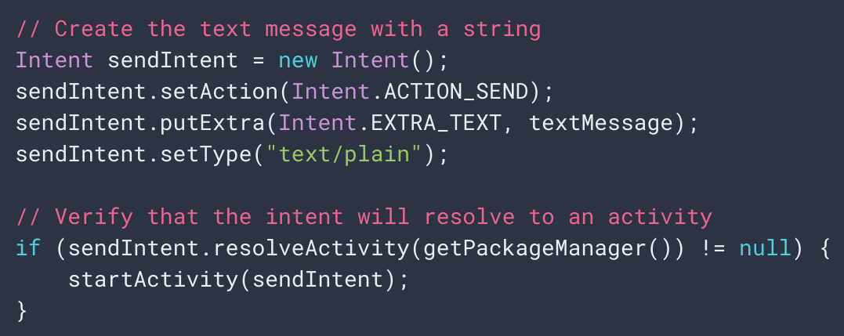
Implicit Intents
This is a SEND action
It sends a text message
Android will search for all Activities that can handle a SEND action on plain text.
Notes:
Using an implicit intent is useful when your app cannot perform the action, but other apps probably can and you'd like the user to pick which app to use.
For example, if you have content that you want the user to share with other people, create an intent with the ACTION_SEND action and add extras that specify the content to share. When you call startActivity() with that intent, the user can pick an app through which to share the content.
When startActivity() is called, the system examines all of the installed apps to determine which ones can handle this kind of intent (an intent with the ACTION_SEND action and that carries "text/plain" data). If there's only one app that can handle it, that app opens immediately and is given the intent. If multiple activities accept the intent, the system displays a dialog such as the one shown in Figure 2, so the user can pick which app to use.

Slide 21
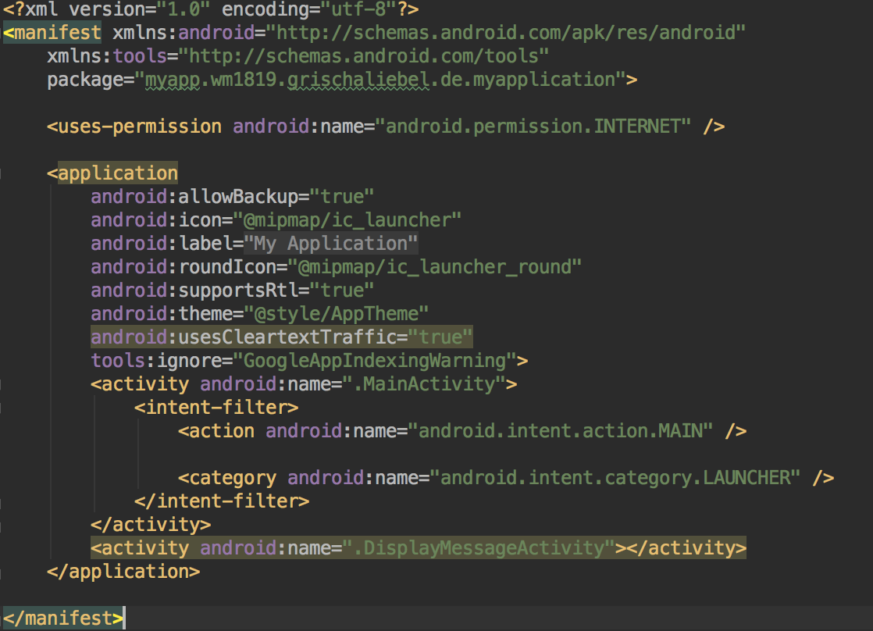
The Manifest
Each android app needs an AndroidManifest.xml file
Essential information
App name
Components
SDK version
Permissions
...
Notes:
Before the Android system can start an app component, the system must know that the component exists by reading the app's manifest file, AndroidManifest.xml. Your app must declare all its components in this file, which must be at the root of the app project directory.
The manifest Identifies any user permissions the app requires, such as Internet access or read-access to the user's contacts. IT Declares the minimum API Level required by the app, based on which APIs the app uses.It Declares hardware and software features used or required by the app, such as a camera, bluetooth services, or a multitouch screen. IIt Declares API libraries the app needs to be linked against (other than the Android framework APIs), such as the Google Maps library.

Slide 22
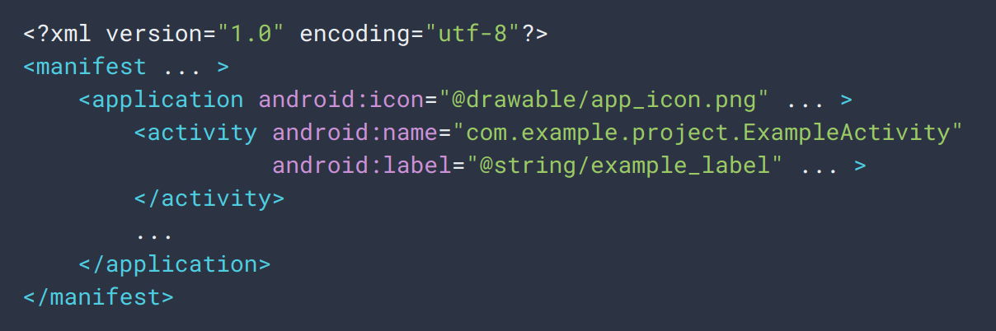
Declaring Components
Resource for an icon.
Class name of Activity
Declares an Activity
Label used to identify Activity
Notes:
The primary task of the manifest is to inform the system about the app's components. We place an entry for each activity, for example, as on the slide.
In the <application> element, the android:icon attribute points to resources for an icon that identifies the app. You declare all app components using <activity> elements for activities.<service> elements for services.<receiver> elements for broadcast receivers.<provider> elements for content providers. Activities, services, and content providers that you include in your source but do not declare in the manifest are not visible to the system and, consequently, can never run.
In the <activity> element, the android:name attribute specifies the fully qualified class name of the Activity subclass and the android:label attribute specifies a string to use as the user-visible label for the activity.

Slide 23
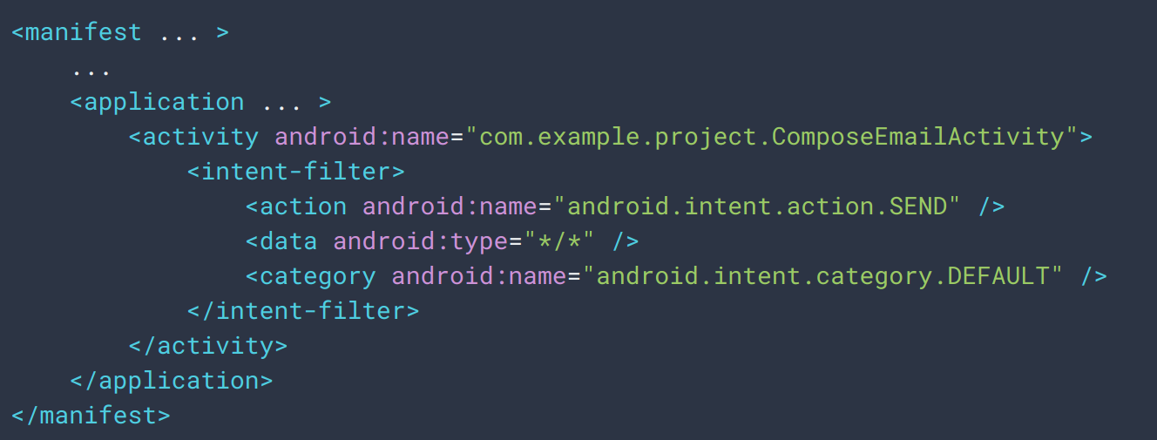
Declaring Component Capabilities
Intent Filters declare how app responds to Intents
This Activity is registered as an option for ACTION_SEND intents.
Notes:
The system identifies the components that can respond to an intent by comparing the intent received to the intent filters provided in the manifest file of other apps on the device.
When you declare an activity in your app's manifest, you can optionally include intent filters that declare the capabilities of the activity so it can respond to intents from other apps. You can declare an intent filter for your component by adding an <intent-filter> element as a child of the component's declaration element.
For example, if you build an email app with an activity for composing a new email, you can declare an intent filter to respond to "send" intents (in order to send a new email), as shown here (go over - if a send intent goes out, it can be picked up by this activity, which will open a compose window)

Slide 24
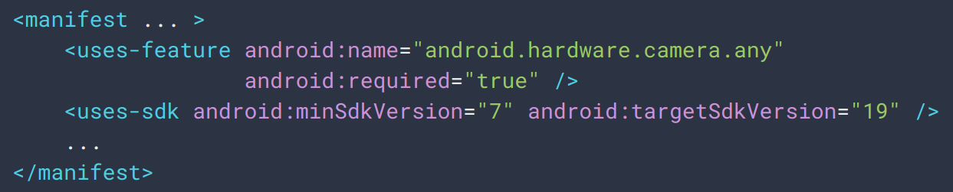
Declaring App Requirements
App requires at least Android 2.1 and a camera.
Setting “required” attribute to false indicates that the app uses the camera, but can function without.
Notes:
There are a variety of devices powered by Android and not all of them provide the same features. To prevent your app from being installed on devices that lack features needed by your app, it's important that you clearly definethe types of devices your app supports in your manifest file. For example, if your app requires a camera and uses APIs introduced in Android 2.1 (API Level 7), you declare these as requirements in your manifest file (point out)
With the declarations shown in the example, devices that do not have a camera or have an Android version lower than 2.1 cannot install your app from Google Play. However, you can declare that your app uses the camera, but does not require it. In that case, your app must set the required attribute to false and check at runtime whether the device has a camera and disable any camera features as appropriate.

Slide 25
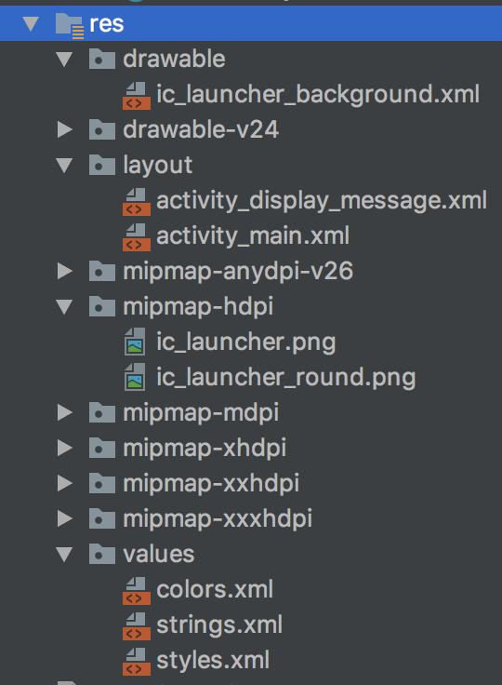
App Resources
Bitmaps/Pictures
UI definitions in XML
Launcher icons
Text strings (incl. translations)
Notes:
An Android app is composed of more than just code—it requires resources that are separate from the source code, such as images, audio files, and anything relating to the visual presentation of the app. For example, you can define animations, menus, styles, colors, and the layout of activity user interfaces with XML files. Using app resources makes it easy to update various characteristics of your app without modifying code. Providing sets of alternative resources enables you to optimize your app for a variety of device configurations, such as different languages and screen sizes.

Slide 26
App Resources
Each resource is assigned a unique ID.
Used to reference the resource from code or layout XML.
File res/drawable/logo.png -> ID R.drawable.logo
Can provide alternate resources for configurations.
UI strings can be used to swap one language for another
Qualifier appended to directory (res/values-fr/)
Many default qualifiers supported for different screen sizes, device types, orientations (layout vs portrait).
Allows automated responsiveness.
Notes:
For every resource that you include in your Android project, the SDK build tools define a unique integer ID, which you can use to reference the resource from your app code or from other resources defined in XML. For example, if your app contains an image file named logo.png(saved in the res/drawable/ directory), the SDK tools generate a resource ID named R.drawable.logo. This ID maps to an app-specific integer, which you can use to reference the image and insert it in your user interface.
One of the most important aspects of providing resources separate from your source code is the ability to provide alternative resources for different device configurations. For example, by defining UI strings in XML, you can translate the strings into other languages and save those strings in separate files. Then Android applies the appropriate language strings to your UI based on a language qualifier that you append to the resource directory's name (such as res/values-fr/ for French string values) and the user's language setting.
Android supports many different qualifiers for your alternative resources. or example, you should create different layouts for your activities, depending on the device's screen orientation and size. When the device screen is in portrait orientation (tall), you might want a layout with buttons to be vertical, but when the screen is in landscape orientation (wide), the buttons could be aligned horizontally. To change the layout depending on the orientation, you can define two different layouts and apply the appropriate qualifier to each layout's directory name. Then, the system automatically applies the appropriate layout depending on the current device orientation.

Slide 27
Permissions
By default, apps are not allowed to use hardware, access data, access network.
Permissions must be explicitly asked for in manifest
Users must grant permission for dangerous requests (like the ones above).
Formerly, user had to agree to all requests to install app (< API 6.0 (23)).
Now, permissions granted individually.
Notes:
The purpose of a permission is to protect the privacy of an Android user. Android apps must request permission to access sensitive user data (such as contacts and SMS), as well as certain system features (such as camera and internet). A central design point of the Android security architecture is that no app, by default, has permission to perform any operations that would adversely impact other apps, the operating system, or the user. This includes reading or writing the user's private data (such as contacts or emails), reading or writing another app's files, performing network access, keeping the device awake, and so on.
An app must publicize the permissions it requires by including <uses-permission> tags in the app manifest. If your app lists normal permissions in its manifest (that is, permissions that don't pose much risk to the user's privacy or the device's operation), the system automatically grants those permissions to your app.If your app lists dangerous permissions in its manifest (that is, permissions that could potentially affect the user's privacy or the device's normal operation), such as the SEND_SMS permission above, the user must explicitly agree to grant those permissions.
(last two points) - this means that now, you can deny certain requests - you could prevent an app from using the camera or your location - and it can still partially function.

Slide 28
Let’s Take a Break

Slide 29
Demonstration - “My First App”
Want to work along? This demonstration follows:
https://developer.android.com/training/basics/firstapp
You will need to install Android Studio, at least one emulator, and download the sample project.
This demonstration follows sections:
Create an Android project
Run your app

Slide 30
Designing Activities

Slide 31
The Concept of Activities
Rather than interacting with apps as atomic units, Activities interact directly with Activities.
Any Activity can serve as an entry point to app interaction
An Activity has a UI, and is usually a single screen.
An app may have a Settings Activity, a Select Photo Activity, ...
One Activity is the “main activity”.
Launches when you click the icon.
Activities must have minimal dependencies on other Activities.
Notes:
Let’s return to Activities. Apps differs from their desktop counterpart in that a user's interaction doesn't always begin in the same place. For instance, if you open an email app from your home screen, you might see a list of emails. By contrast, if you are using a social media app that then launches your email app, you might go directly to composing an email. The Activity class is designed to facilitate this. When one app invokes another, the calling app invokes an activity in the other app, rather than the app as an atomic whole. In this way, the activity serves as the entry point for an app's interaction with the user. You implement an activity as a subclass of the Activity class.
An activity provides the window in which the app draws its UI. Generally, one activity implements one screen in an app. For instance, one of an app’s activities may implement a Preferences screen, while another activity implements a Select Photo screen. Most apps contain multiple screens, which means they comprise multiple activities. Typically, one activity in an app is specified as the main activity, which is the first screen to appear when the user launches the app. Each activity can then start another activity in order to perform different actions. Although activities work together, there are usually minimal dependencies among the activities in an app. This is what allows Activities to easily start activities in other, potentially unknown apps.

Slide 32
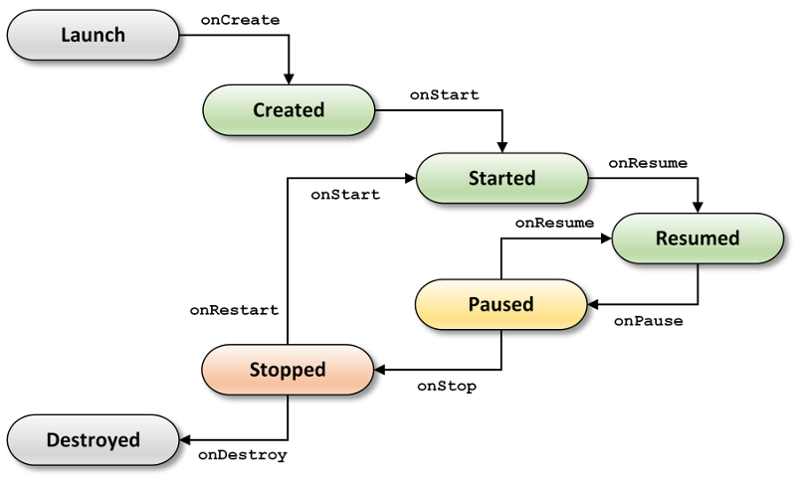
Activity Lifecycle
Activity dismissed, configuration change (e.g., rotation)
Other Activity in foreground, incoming phone call, ...
Activity no longer visible (e.g., new activity started)
Notes:
Over the course of its lifetime, an activity goes through a number of states. You use a series of callbacks to handle transitions between states. These are the transitions in this state diagram
onCreate() - This fires when the system creates your activity. Your implementation should initialize the components of your activity: For example, your app should create the layout and bind data to lists here. When onCreate() finishes, the next callback is always onStart().
onStart() - As onCreate() exits, the activity enters the Started state, and the activity becomes visible to the user. This callback contains final preparations for coming to the foreground and becoming interactive.
onResume() - The system invokes this callback just before the activity starts interacting with the user. At this point, the activity is at the top of the activity stack, and captures all user input. Most of an app’s core functionality is implemented in the onResume() method.
The onPause() callback always follows onResume().
onPause() - The system calls onPause() when the activity loses focus and enters a Paused state. This state occurs when, for example, the user taps the Back button or answers a phone call. When the system calls onPause() for your activity, it technically means your activity is still partially visible, but most often is an indication that the user is leaving the activity, and the activity will soon enter the Stopped or Resumed state. An activity in the Paused state may continue to update the UI if the user is expecting the UI to update.A media player might update the track playing. Even if such activities lose focus, the user expects their UI to continue updating. You should not use onPause() to save application or user data, make network calls, or execute database transactions.
Once onPause() finishes executing, the next callback is either onStop() or onResume(), depending on what happens after the activity enters the Paused state.
onStop() - The system calls onStop() when the activity is no longer visible to the user. This may happen because the activity is being destroyed, a new activity is starting, or an existing activity is entering a Resumed state and is covering the stopped activity. In all of these cases, the stopped activity is no longer visible at all. The next callback that the system calls is either onRestart(), if the activity is coming back to interact with the user, or by onDestroy() if this activity is completely terminating.
onRestart() - The system invokes this callback when an activity in the Stopped state is about to restart. onRestart() restores the state of the activity from the time that it was stopped.This callback is always followed by onStart().
onDestroy() - The system invokes this callback before an activity is destroyed. This callback is the final one that the activity receives. onDestroy() is usually implemented to ensure that all of an activity’s resources are released when the activity, or the process containing it, is destroyed.

Slide 33
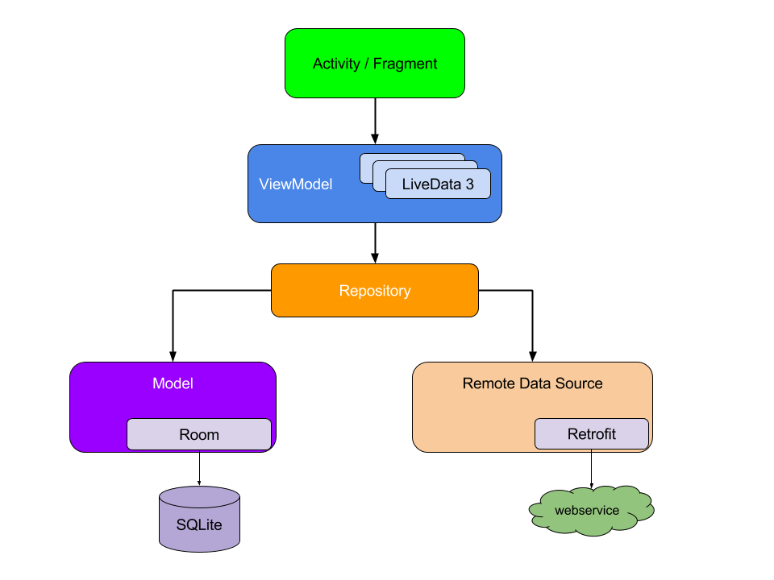
App Architecture
Activity code manages state, captures user input
Creates and presents the on-screen layout.
Models process, load, and store app data locally.
Data can also be loaded, stored, and processed from remote sources.
Notes:
What does the architecture of an activity look like? Usually, this is a layered architecture, where each component depends only on the component one level below it. At the top is the code that controls the activity. This should not contain business logic for performing the underlying functionality. Rather, the Activity code coordinates the underlying UI and translates user input into actions. One layer below is the ViewModel. This is the layout of the user interface - the presentation layer that determines what appears on screen. You should drive your UI from a model, preferably a persistent model. Models are components that are responsible for handling the data for an app. They're independent from the layout objects and app components in your app, so they're unaffected by the app's lifecycle and the associated concerns. Persistence is ideal because Your users don't lose data if the Android OS destroys your app to free up resources. Your app continues to work in cases when a network connection is flaky or not available. By basing your app on model classes with the well-defined responsibility of managing the data, your app is more testable and consistent. . Regardless of whether the user comes back to the app several minutes after they've last closed it or several days later, they instantly see a user's information that the app persists locally. If this data is stale, the app's repository module starts updating the data in the background.

Slide 34
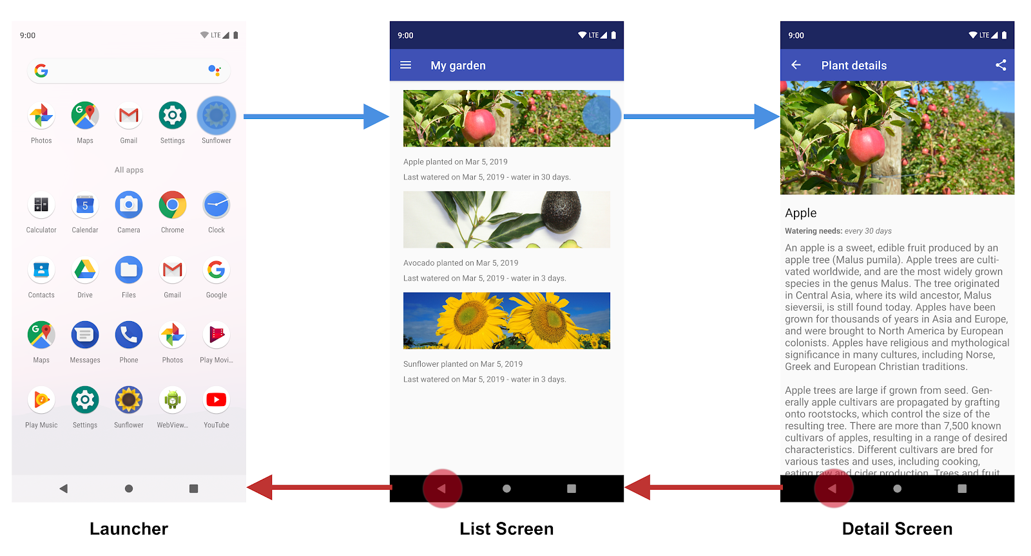
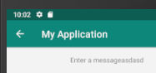
Navigation
All apps have a fixed start location.
A stack of Activities is maintained. When you press back, you pop from the stack.
Also provide “up navigation”.
(exit a chain to a set location)
Define a parent activity in the manifest.
Notes:
Navigation between different screens and apps is a core part of the user experience, but this is something you need to plan for. How do you resume an activity that you left temporarily. How do you get from one activity to another?
Every app you build has a fixed start destination. This is the first screen the user sees when they launch your app from the launcher. This destination is also the last screen the user sees when they return to the launcher after pressing the Back button. Navigation state is represented as a stack of destinations. (2).
You should also provide (3) - A way to exit a chanin back to a set location. This is done by defining a parent activity in the manifest, then ensuring a “up” button is in your layout.

Slide 35
Activity Best Practices
Activities should coordinate with Data Models to retrieve a minimal amount of relevant data.
Create independent, well-defined code modules.
Make each module testable in isolation.
Do not write code if an existing Activity does it.
Use Models to persist fresh, relevant data.
Assign one data source as the source of truth.
Notes:
There are a few recommendations we can make that will make your code base more robust, testable, and maintainable in the long run:
Avoid designating your app's entry points—such as activities, services, and broadcast receivers—as sources of data. Instead, they should only coordinate with other components to retrieve the subset of data that is relevant to that entry point. Each app component is rather short-lived, depending on the user's interaction with their device and the overall current health of the system.
Create well-defined boundaries of responsibility between various modules of your app. For example, don't spread the code that loads data from the network across multiple classes or packages in your code base. Similarly, don't define multiple unrelated responsibilities—such as data caching and data binding—into the same class.
Consider how to make each module testable in isolation. For example, having a well-defined API for fetching data from the network makes it easier to test the module that persists that data in a local database. If, instead, you mix the logic from these two modules in one place, or distribute your networking code across your entire code base, it becomes much more difficult—if not impossible—to test.
Focus on the unique core of your app so it stands out from other apps.Don't reinvent the wheel by writing the same boilerplate code again and again. Instead, focus your time and energy on what makes your app unique, and let the Android Architecture Components and other recommended libraries handle the repetitive boilerplate.
Persist as much relevant and fresh data as possible. That way, users can enjoy your app's functionality even when their device is in offline mode. Remember that not all of your users enjoy constant, high-speed connectivity.
Assign one data source to be the single source of truth. Whenever your app needs to access this piece of data, it should always originate from this single source of truth. If other data sources disagree with it, take the data from this source.

Slide 36
Designing User Interfaces

Slide 37
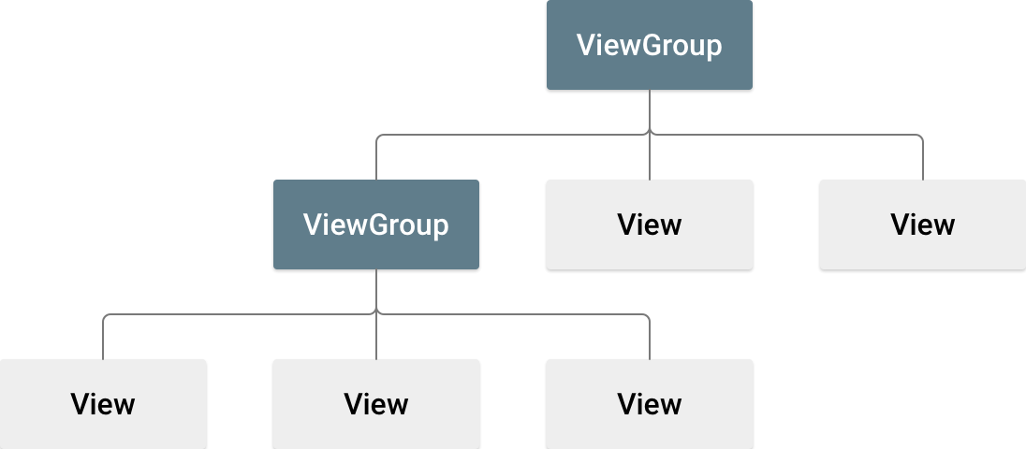
UI Design - Views and Layouts
A layout (ViewGroup) defines the structure of the UI.
Containers that group one or more widgets (View).
A button, a text box.
Many pre-defined types of layouts (LinearLayout, Constraint Layout).
UI elements can be declared in XML or in code.
Notes:
A layout defines the structure for a user interface in your app, such as in an activity. All elements in the layout are built using a hierarchy of View and ViewGroup objects. A View usually draws something the user can see and interact with. The View objects are usually called "widgets" and can be one of many subclasses, such as Button or TextView. Whereas a ViewGroup is an invisible container that defines the layout structure for View and other ViewGroup objects. TheViewGroup objects are usually called "layouts" can be one of many types that provide a different layout structure, such as LinearLayout or ConstraintLayout .
You can declare a layout in two ways: Declare UI elements in XML. Android provides a straightforward XML vocabulary that corresponds to the View classes and subclasses, such as those for widgets and layouts. Instantiate layout elements at runtime. Your app can create View and ViewGroup objects (and manipulate their properties) programmatically.

Slide 38
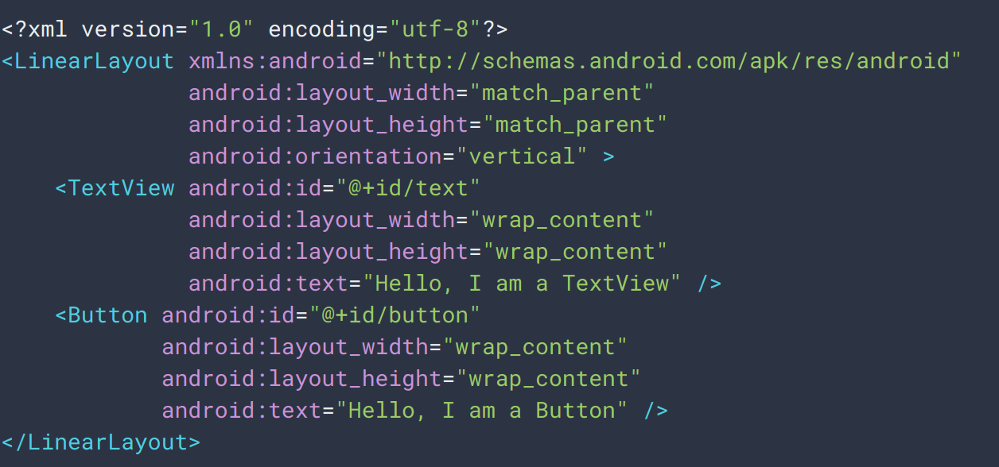
UI Design - XML
Layout has two widgets, which have no constraints on each other’s size or location
Text box containing a set string
Button with a set string.
Notes:
Declaring your UI in XML allows you to separate the presentation of your app from the code that controls its behavior. Using XML files also makes it easy to provide different layouts for different screen sizes and orientations. Using Android's XML vocabulary, you can quickly design UI layouts and the screen elements they contain, in the same way you create web pages in HTML — with a series of nested elements. In fact, it makes it possible to not have to write code or XML for the layout at all - You can also use Android Studio's Layout Editor to build your XML layout using a drag-and-drop interface which generates the XML - I’ll show you that in a few minutes. Each layout file must contain exactly one root element, which must be a View or ViewGroup object. Once you've defined the root element, you can add additional layout objects or widgets as child elements to gradually build a View hierarchy that defines your layout. For example, here's an XML layout that uses a vertical LinearLayout - organizes its widgets into a single horizontal or vertical row - to hold a TextView and a Button (go over) -

Slide 39
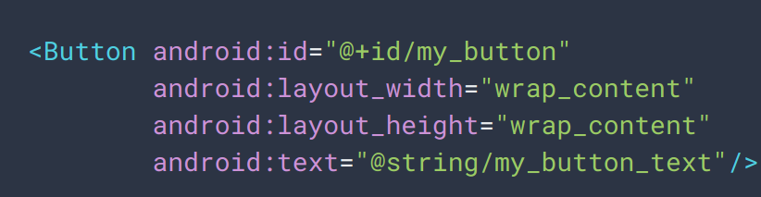
UI Design - Attributes
All View objects have a unique identifier.
Integer assigned at compile time, mapped to a user-specified variable: android:id=”@+id/my_button”
Notes:
Every View and ViewGroup object supports their own variety of XML attributes. Some attributes are specific to a View object (for example, TextView supports the textSize attribute), Some are common to all View objects, because they are inherited from the root View class. And, other attributes are considered "layout parameters," which are attributes that describe certain layout orientations of the View object, as defined by that object's parent ViewGroup.
Any View object may have an integer ID associated with it, to uniquely identify the View within the tree. When the app is compiled, this ID is referenced as an integer, but the ID is typically assigned in the layout XML file as a string, in the idattribute. The at-symbol (@) at the beginning of the string indicates that the XML parser should parse and expand the rest of the ID string and identify it as an ID resource. The plus-symbol (+) means that this is a new resource name that must be created and added to our resources. It is given the variable “my_button”
n order to create views and reference them from the app, a common pattern is to Define a view/widget in the layout file and assign it a unique ID (first pic), Then create an instance of the view object and capture it from the layout (typically in the onCreate() method) (second pic)

Slide 40
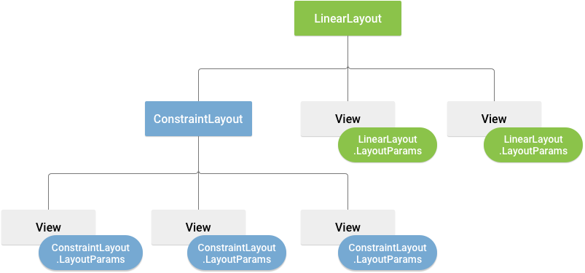
UI Design - Attributes
LayoutParameters
Inherited by Views contained in that layout.
Define how Views appear.
All ViewGroups have a width and height.
Each view must define width and height relative to this.
wrap_content sizes view to its content.
match_parent makes view as big as its parent ViewGroup allows.
Specify in dp (density-independent pixel units)
Notes:
XML layout attributes named layout_something define layout parameters for the View that are appropriate for the ViewGroup in which it resides. Every ViewGroup class implements a nested class that extends ViewGroup.LayoutParams. This subclass contains property types that define the size and position for each child view, as appropriate for the view group. As you can see here, the parent ViewGroup defines layout parameters for each child view.
All view groups include a width and height (layout_width and layout_height), and each view is required to define them. Many LayoutParams also include optional margins and borders. You can specify width and height with exact measurements, though you probably won't want to do this often. More often, you will use one of these constants to set the width or height: wrap_content tells your view to size itself to the dimensions required by its content, match_parent tells your view to become as big as its parent view group will allow.
In general, specifying a layout width and height using absolute units such as pixels is not recommended. Instead, using relative measurements such as density-independent pixel units (dp), wrap_content, or match_parent, is a better approach, because it helps ensure that your app will display properly across a variety of device screen sizes.

Slide 41
UI Design - Layouts
Views are rectangles with left and top coordinates.
Can get location with getLeft() and getTop()
Defined relative to the parent.
Size is defined in width and height.
Measured width/height are how big the view wants to be.
Drawing width/height are the actual size of the view on screen, after layout constraints.
These can differ.
Notes:
The geometry of a view is that of a rectangle. A view has a location, expressed as a pair of left and top coordinates, and two dimensions, expressed as a width and a height. The unit for location and dimensions is the pixel. It is possible to retrieve the location of a view by invoking the methods getLeft() and getTop(). These methods both return the location of the view relative to its parent. For instance, when getLeft() returns 20, that means the view is located 20 pixels to the right of the left edge of its direct parent.
The size of a view is expressed with a width and a height. A view actually possesses two pairs of width and height values. The first pair is known as measured width and measured height. These dimensions define how big a view wants to be within its parent. The second pair is simply known as width and height, or sometimes drawing width and drawing height. These dimensions define the actual size of the view on screen, at drawing time and after layout. These values may, but do not have to, be different from the measured width and height.

Slide 42
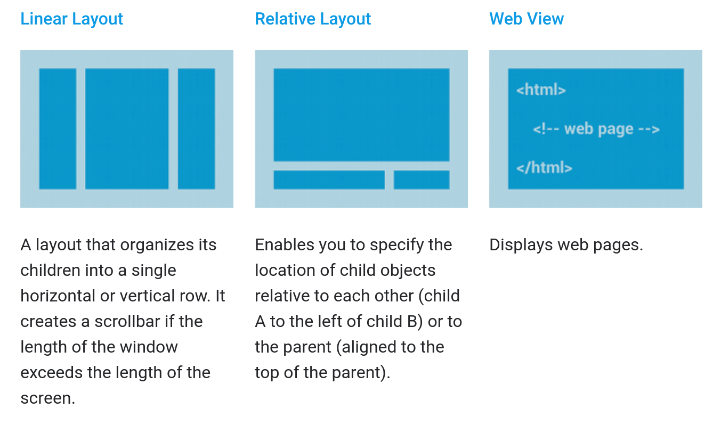
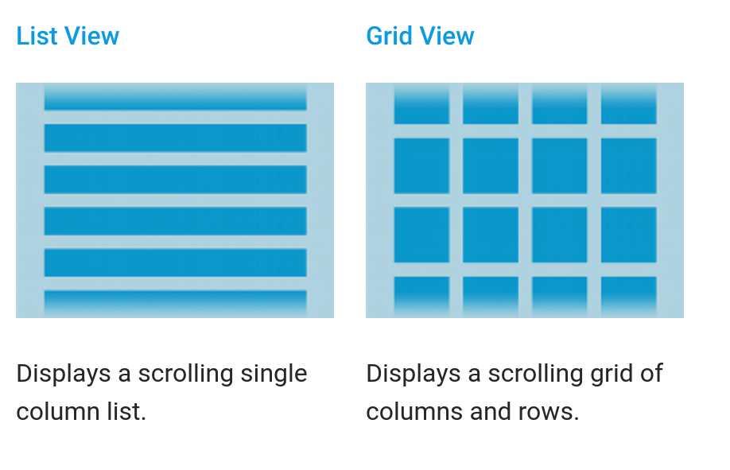
UI Design - Common Layouts
Built from data using an Adapter
Notes:
(go over left three)
When the content for your layout is dynamic or not pre-determined, you can use a AdapterViewto populate the layout with views at runtime. A subclass of the AdapterView class uses an Adapter to bind data to its layout. The Adapter behaves as a middleman between the data source and the AdapterView layout—the Adapterretrieves the data and converts each entry into a view that can be added into the AdapterView layout. (go over right two)

Slide 43
UI Design - Responsive Design
Android defines two characteristics for each screen:
Screen Size (physical size)
Small, Normal, Large, XLarge
Screen Density (density of pixels on screen)
MDPI (~160dpi), HDPI (~240dpi), XHDPI (~320dpi), XXHDPI (~480dpi), XXXHDPI (~640dpi)
Apps are compatible with all screen sizes and densities automatically, but this may not create a good UX.
Create specialized layouts, optimize images for density.
Notes:
Android runs on devices of various sizes, from phones to tablets and TVs. In order to categorize devices by their screen type, Android defines two characteristics for each device: screen size (the physical size of the screen) and screen density (the physical density of the pixels on the screen, known as DPI). To simplify the different configurations, Android generalizes these variants into groups that make them easier to target: Four generalized sizes: small, normal, large, and xlarge - about 92% of devices have a normal sized screen..And several generalized densities: mdpi (medium), hdpi (high), xhdpi (extra high), xxhdpi (extra-extra high), and others (currently, is most common XHDPI - 42%).
By default, your app is compatible with all screen sizes and densities, because the system makes the appropriate adjustments to your UI layout and image resources as necessary for each screen. However, you should optimize the user experience for each screen configuration by adding specialized layouts for different screen sizes and optimized bitmap images for common screen densities.

Slide 44
Creating a Flexible Layout
ConstraintLayout allows position/size specification based on spatial relationships between views.
All views move together as screen size changes.
Easiest to create in Android Studio Layout Editor.
Avoid hard-coded layout sizes.
Use wrap_content, match_parent.
Automatically adjusts based on size and orientation of screen.
Notes:
No matter what hardware profile you want to support first, you need to create a layout that is responsive to even small variations in screen size. The best way to create a responsive layout for different screen sizes is to use ConstraintLayout as the base layout in your UI. ConstraintLayout allows you to specify the position and size for each view according to spatial relationships with other views in the layout. This way, all the views can move and stretch together as the screen size changes. The easiest way to build a layout with ConstraintLayout is to use the Layout Editor in Android Studio. It allows you to drag new views to the layout, attach their constraints to the parent view and other sibling views, and edit the view's properties, without editing any XML by hand
Avoid hard-coded layout sizes. To ensure that your layout is flexible and adapts to different screen sizes, you should use "wrap_content" and "match_parent" for the width and height of most view components, instead of hard-coded sizes. "wrap_content" tells the view to set its size to whatever is necessary to fit the content within that view."match_parent" makes the view expand to as much as possible within the parent view. This allows the view to adapt to different screen sizes and different lengths of text, even adapting when you switch from portrait to landscape mode.

Slide 45
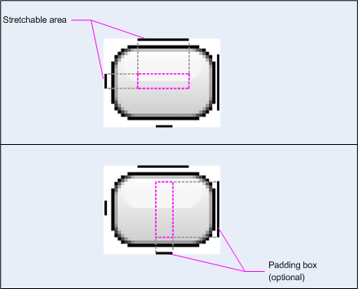
Create Stretchable Images
Bitmaps stretch to the screen size and density.
This can cause blurring and scaling artifacts.
Nine-patch bitmaps add a 1px border that indicates which pixels can be stretched.
Intersection between left/top lines indicates the area that can be stretched.
Notes:
If you use a bitmap as the background in a view that changes size, you will notice Android scales your images as the view grows or shrinks based on the size of the screen or content in the view. This often leads to visible blurring or other scaling artifacts. The solution is using nine-patch bitmaps, which are specially formatted PNG files that indicate which areas can and cannot be stretched. A nine-patch bitmap is basically a standard PNG file, but with an extra 1px border that indicates which pixels should be stretched (and with a .9.png extension instead of just .png). As shown here, the intersection between the black lines on the left and top edge is the area of the bitmap that can be stretched. Optionally, you can also define the safe region where content should go inside the view by similarly adding lines on the right and bottom edges.When you apply a nine-patch as the background to a view, the framework stretches the image correctly to accommodate the size of the button.

Slide 46
Demonstration - UI Design
Want to work along? This demonstration follows:
https://developer.android.com/training/basics/firstapp
You will need to install Android Studio, at least one emulator, and download the sample project.
This demonstration follows sections:
Build a simple user interface
Start another activity

Slide 47
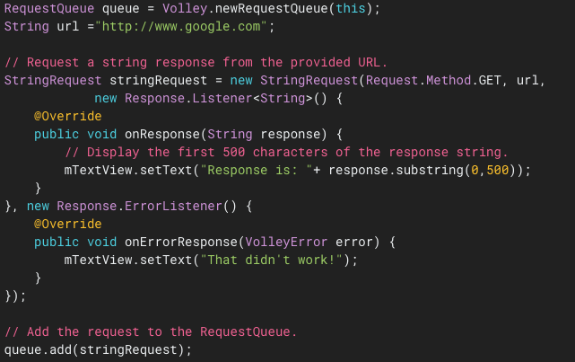
HTTP Requests - Volley Library
Create a RequestQueue and pass Request objects.
Thread safe
Requires INTERNET permission in manifest.
https://developer.android.com/training/volley/simple#java
Notes:
Now, as part of your project you need to make REST requests over HTTP. How do you do that in Android? (title)you use Volley by creating a RequestQueue and passing it Request objects. The RequestQueue manages worker threads for running the network operations, reading from and writing to the cache, and parsing responses. Requests do the parsing of raw responses and Volley takes care of dispatching the parsed response back to the main thread for delivery.
To use Volley, you must add the android.permission.INTERNETpermission to your app's manifest.
Volley provides a convenience method Volley.newRequestQueue that sets up a RequestQueue for you, using default values, and starts the queue.To send a request, you simply construct one and add it to the RequestQueue with add(), as shown above. Once you add the request it moves through the pipeline, gets serviced, and has its raw response parsed and delivered. When you call add(), Volley runs one cache processing thread and a pool of network dispatch threads. When you add a request to the queue, it is picked up by the cache thread and triaged: if the request can be serviced from cache, the cached response is parsed on the cache thread and the parsed response is delivered on the main thread. If the request cannot be serviced from cache, it is placed on the network queue. The first available network thread takes the request from the queue, performs the HTTP transaction, parses the response on the worker thread, writes the response to cache, and posts the parsed response back to the main thread for delivery.
(point out request, GET, etc)

Slide 48
What’s Next?
Wednesday: Android Supervision
Thursday: More Android!
Testing
Profiling
Processes and Threads
Services
Broadcast Receivers
Content Providers

